Slide 1


Connect® for Al Akhawayn University
Presenter Name: Mona Nashed

Slide 2
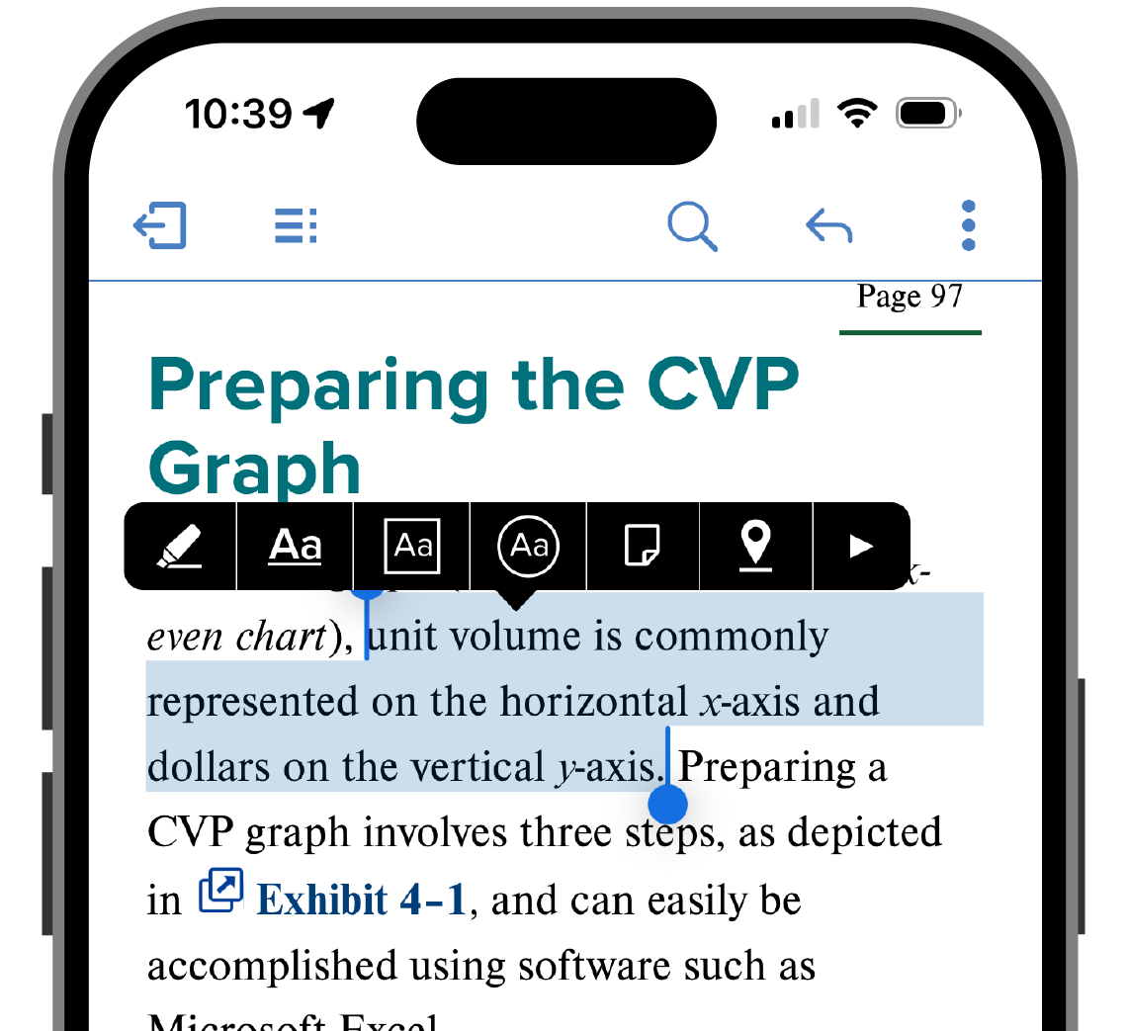


Why Use Connect?
Don't forget to download the ReadAnywhere app!​
Connect is your personalized digital learning platform that makes studying and getting work done easier and more convenient than ever.​
Download & read your textbook online or offline​
Listen to your textbook with audio functionality​
Highlight & make notes​
Complete SmartBook assignments on-the-go​
Optimize your study time & increase your grade potential
Access your assignments & course resources in one place
Focus on what you need to know with SmartBook, Connect's personalized learning tool
Get immediate feedback & track your progress throughout the course

Slide 3
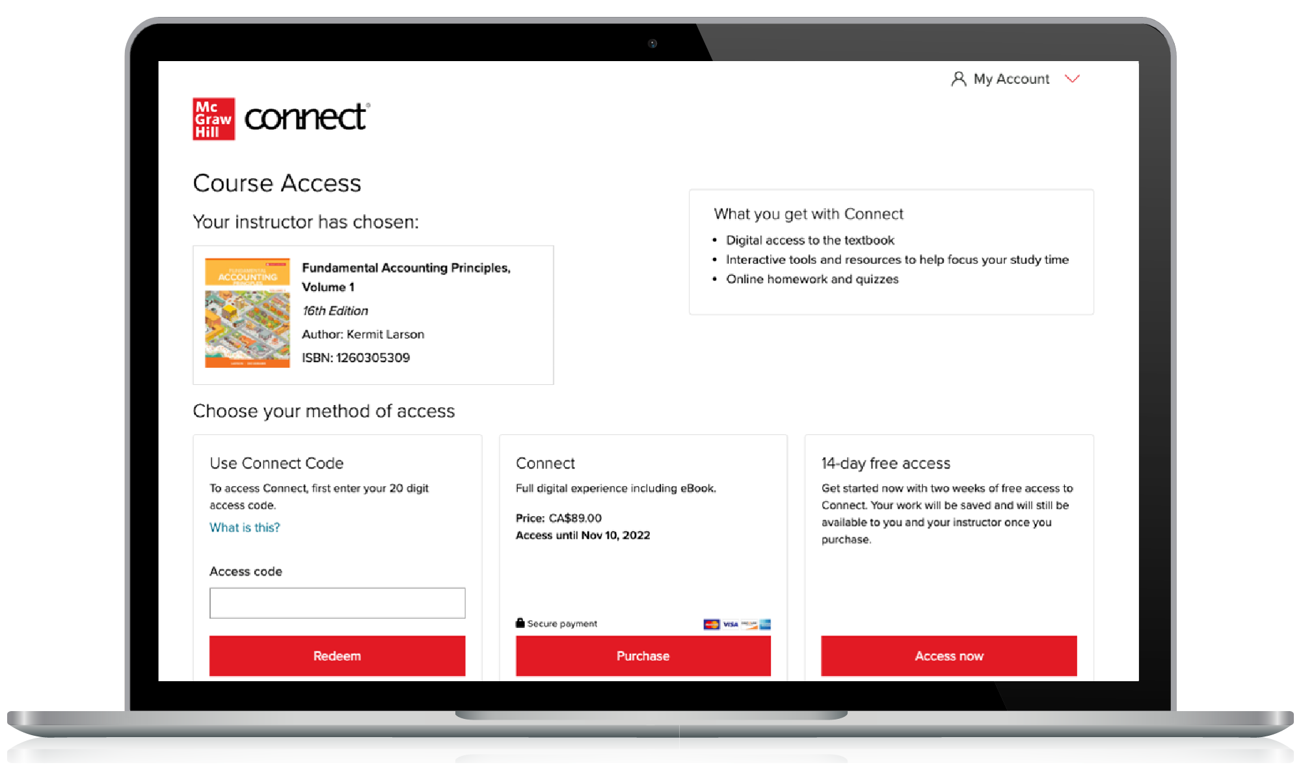
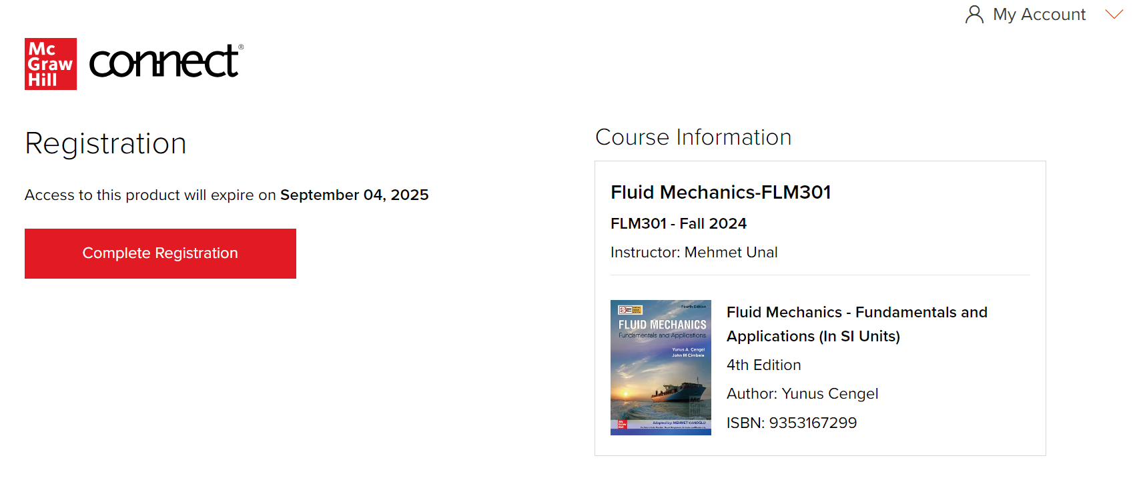
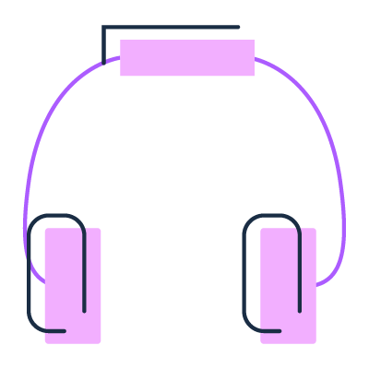
How to Register
With Inclusive Access
Step 1: Click on the McGraw Hill Connect link inside your Canvas course
Step 2: Enter your password and sign in (if you are an existing user) or click “Create a new account”.​
Click here for a registration tutorial

Slide 4
Useful Videos
Checkout these resources to learn about Connect, how to access your eBook and how to complete your assignments
Navigating Connect
Navigating the eBook
Completing Assignments
SmartBook Assignments

Slide 5

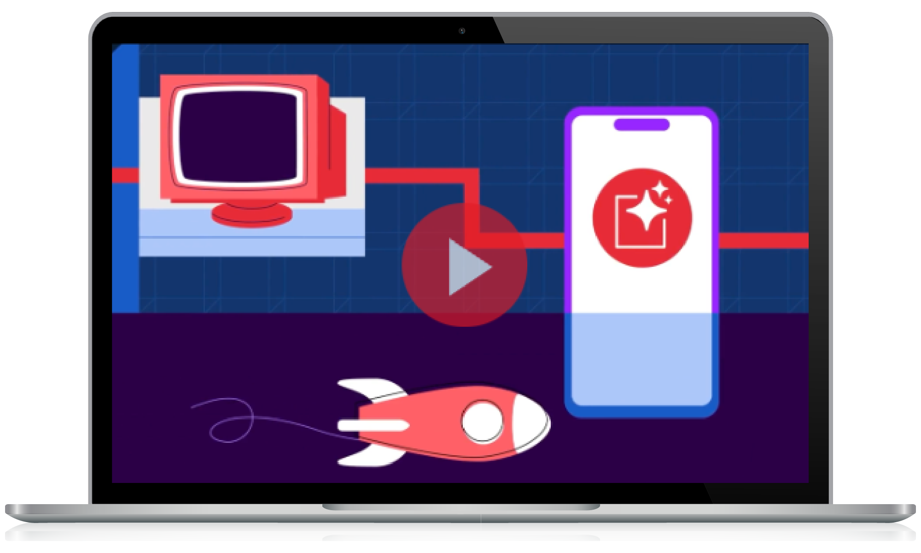
AI Reader
Available within the eBook inside Connect, and in SmartBook, AI Reader encourages active reading and boosts understanding with the power of generative AI.​
You are empowered to enhance your own learning with AI.​
Highlight words or passages to get a simplified explanation.​
Save explanations to your notes for later reference.​
Generate personalized quiz questions to check your understanding.​
Decades of trusted, vetted content and technology.​
For more than 135 years, McGraw Hill has been committed to providing high-quality, peer-reviewed content, and this commitment continues with AI Reader. AI Reader is trained using McGraw Hill’s own instructional content, so you can rest assured knowing that you are benefitting from an AI tool that is seamlessly integrated and based on your course materials.

Slide 6



Proctorio
McGraw Hill and Proctorio have partnered to deliver assessment integrity tools within Connect. Your Connect course might include remote proctored assignments.
Browser-Locking Capabilities
Controlled browser activity and other functions used during the assessment.
Video Proctoring
Controlled assessment environment, choosing what is recorded during exams.
Verification Options
Enhanced capabilities will create the best results for verifying your identity.

Slide 7
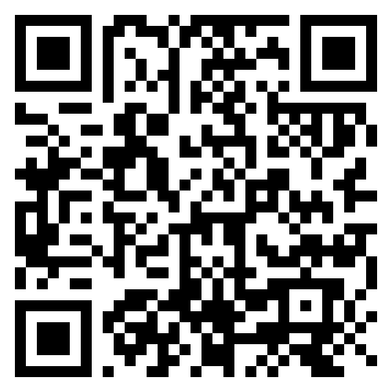
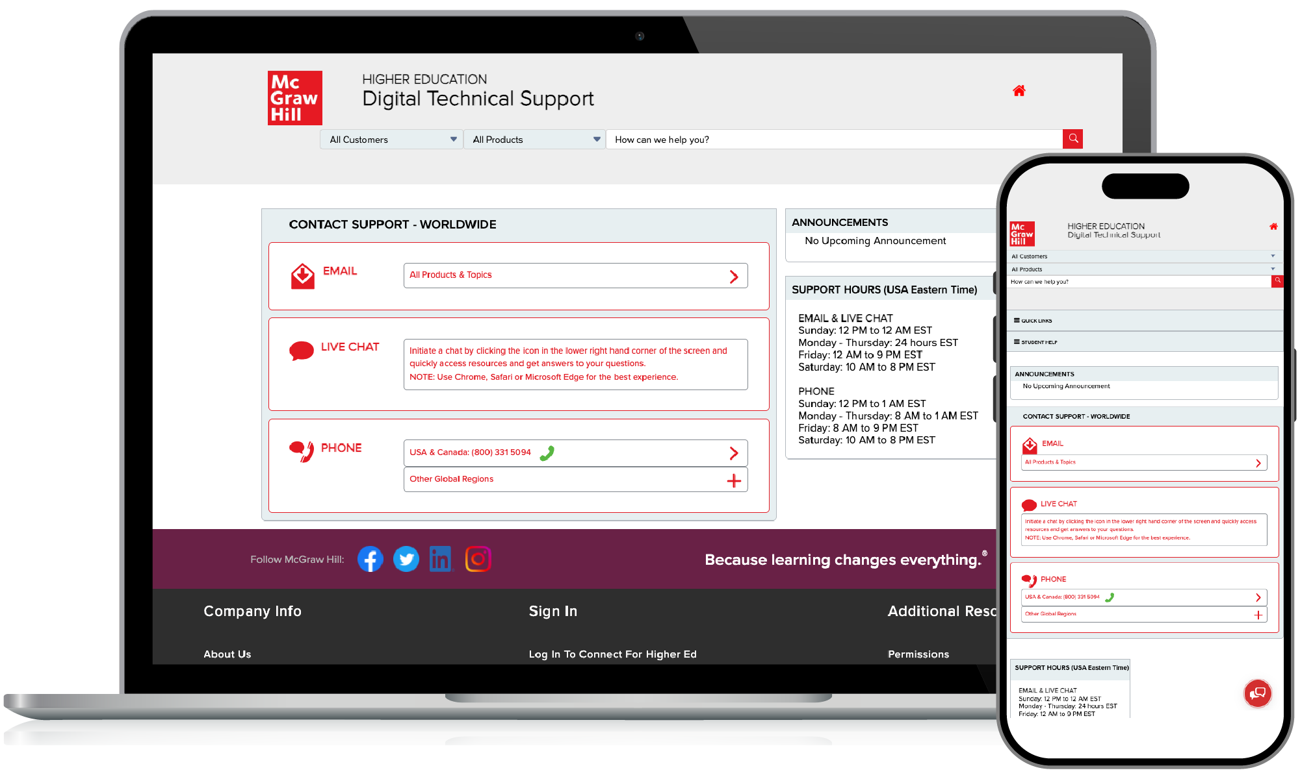
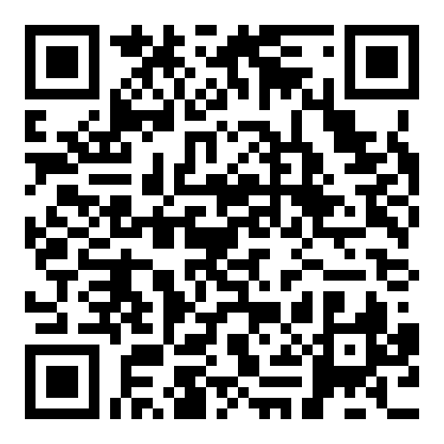

Tech Support
If you need technical help with Connect, use the chat box to talk to our experts.
Click here to get in touch.
FAQs & Guidance
Find helpful videos, articles and more about using Connect here.

