Slide 1

Making the Most of Your Course Tools
Connect® Course Resources for [Insert Course]

Slide 2



About Your Course
Course Name | [Insert Course Name]
Course Code | [Insert Course Code]
Course Section | [Insert Course Section]
Resource | [Title, Edition]
Resource Author | [Last name, First name]
Course URL | [Insert URL]
[[Insert Digital Solution] is xx% of your course grade]
[Insert Quiz and Assignment Details]
ACTION ITEM, DELETE ONCE FINALIZED
Digital Resource Logo: Swap the logo below to appear above your cover. Do not resize.
Resource Cover Image: Click here and search for your cover with the ISBN10 or 13. Drag the ”400 High” image into this document and resize against the grey rectangle.
“About Your Course” Table: Use as many rows as needed, delete rows not in use (highlight rows to remove, right click and select remove rows).
Need help logging in?
Click here to speak with our
Digital Technical Support team

Slide 3

Why Connect?
Connect
Connect Free Trial: Get FREE 14-day access to Connect. Register now at your instructor’s course URL for limited time access.
Connect is your personalized digital learning platform that makes studying and getting work done easier and more convenient than ever.
Maximize your study time with a learning path tailored to you.
Save time – access assignments & learning tools in one place.
Get immediate feedback & track progress to achieve your goals.
Learn online or offline, anytime, anywhere.

Slide 4




Remote Proctoring
Remote Proctoring
Your Connect course includes remote proctored assignments.
Your instructor may require:
Browser-Locking
Video Proctoring
Identity Verification

Slide 5


Personalized Learning
Connect
Your Connect course includes SmartBook, our powerful adaptive learning technology:
Understands what you know – and don’t know – to maximize study time
Helps you focus on learning & recharging key concepts
Quickly creates practice tests to ensure you’re prepared
Learn More about SmartBook for Students

Slide 6
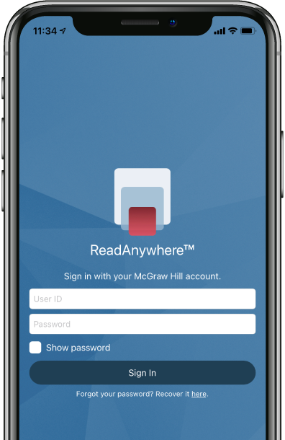


ReadAnywhere App
The FREE ReadAnywhere App makes it easy to read your Connect eBook on your smartphone or tablet so you can study anywhere, anytime.
Complete SmartBook assignments
Listen to your textbook with audio functionality
Sync assignments & notes
Download & read chapters
Work online or offline
Highlight and take notes
Download Now

Slide 7

Purchase Options
Connect
ACTION ITEM, DELETE ONCE FINALIZED
Hyperlink direct product URL from the respective store for ease of use.
McGraw Hill offers a variety of purchase options so you can choose the flexible course materials that suit your learning style.
Print + Connect Package
Connect Online Access
+ Optional Upgrade
eBook
Bookstore: £/€00.00
Online: £/€ 00.00
You will receive a Connect access card, plus colour, print bound version of the complete text.
Bookstore: £/€ 00.00
Online: £/€ 00.00
Online: £/€ 00.00
Add a print textbook to your Connect subscription.
Lifetime: £/€ 39.99 + VAT
180 days: £/€ 27.99 + VAT

Slide 8
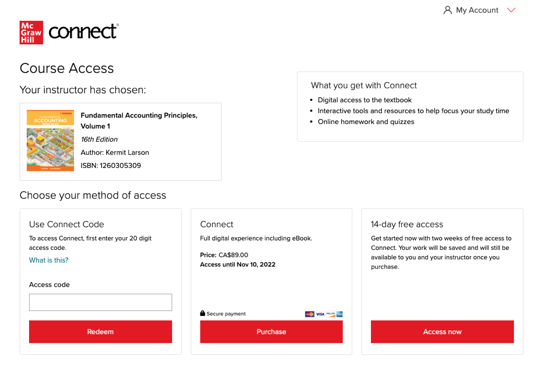
How to Register
Registration
with an Access Code
ACTION ITEM, DELETE ONCE FINALIZED
Edit Connect Course URL
Right click on text
Select Hyperlink
Edit Hyperlink
Paste Connect Course URL
After you have purchased Connect or Connect + Print Text from your bookstore or mheducation.co.uk, go to your Connect Course URL and follow the steps below:
STEP 1: Enter your institution email and sign in or register for a new account.
STEP 2: Enter your 20-digit Connect access code you have pre-purchased from the bookstore or mheducation.co.uk
STEP 3: If you have not already purchased a Connect access code, you can choose [Buy It] for immediate full access, or get a 14-day FREE TRIAL for limited time access
Click here for a quick registration tutorial

Slide 9
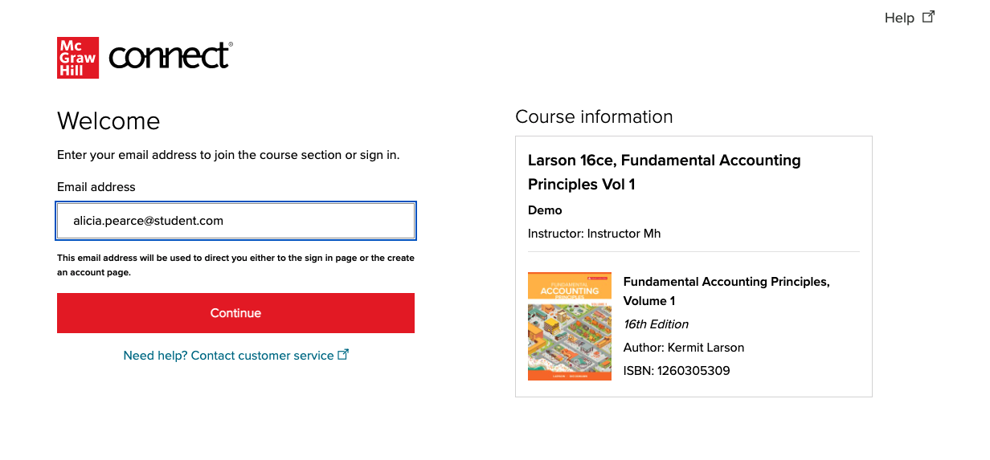

How to Register
Registration
Follow the steps below to register for Connect with Pre-paid access:
STEP 1: Visit your instructor’s Connect Course URL & sign in or register for a new account.
with Prepaid Access
Need more help?
Watch the registration tutorial.

Slide 10

Best Practices
Connect
Use Google Chrome as your internet browser
Clear your browser cache prior to the start of an assignment, simulation, quiz or exam.
Complete a Computer Compatibility Check.
Complete the assignment, simulation, quiz or exam on your laptop or desktop rather than a mobile device.
Reminders
Connect should be loaded on ONE session of your browser and only ONE tab within your browser.
Use an ethernet cable to directly connect your device to your internet modem for faster speeds.
Limit the number of applications running and devices connected to your wireless internet while completing your assignment.

Slide 11


Office Hours
User Note about Table
Optional Slide
DELETE THIS INSTRUCTIONAL TEXT.
ACTION ITEM, DELETE ONCE FINALIZED
Digital Resource Logo: Swap the logo below to appear above your cover. Do not resize.
Resource Cover Image: Click here and search for your cover with the ISBN10 or 13. Drag the ”400 High” image into this document and resize against the grey rectangle.
“About Your Course” Table: Use as many rows as needed, delete rows not in use (highlight rows to remove, right click and select remove rows).
Get additional Connect support from our Digital Success Team by attending an Office Hours session.
Support Contact | [Insert Your Name]
Session 1 | [Date/Time/Link(Hyperlink Zoom URL)]
Session 2 | [Date/Time/Link(Hyperlink Zoom URL)]
Session 3 | [Date/Time/Link(Hyperlink Zoom URL)]

Slide 12

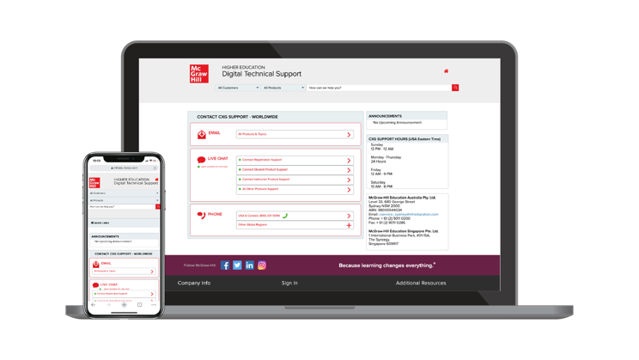
Accessibility & Support
Connect
Accessibility
Support Hours (ET)
Sunday
12 PM – 12 AM
Monday - Thursday
24 Hours
Friday
12 AM – 9 PM
Saturday
10 AM – 8 PM
If you have any questions or concerns about interacting with our products, please contact your institution’s Accessibility Office.
Support
We’re here to help. If you need technical help with Connect, get in touch with our experts:
Phone: +800-881-39190 (Europe, Middle East and Africa)
Web: Get in touch
Student support webpage
mheducation.co.uk/higher-education/students

Slide 13
Thank You!
USER NOTE ABOUT CONTACT INFO
Update the text boxes to the right of each icon with your information.
If you do not include your email address, phone number or LinkedIn address, please delete the icon and the text box to its right, then adjust the height of the white callout box using the horizontal lines of the grid as your guide.
The computer icon and McGraw Hill URL are always to be kept on this slide.
DELETE THIS INSTRUCTIONAL TEXT.
mheducation.co.uk

