Slide 1
AI in a sales class

Slide 2
Discussed in each textbook chapter

Slide 7
End of textbook chapter problems, cases and exercises

Slide 9
Have all guest speakers talk about their use of AI

Slide 11
Can add additional assignments

Slide 12
Started adding additional AI exercises in Fall of 2023

Slide 13
5% of their overall course grade
Directions:
Use Generative AI (like ChatGPT) to create the following content. Make several iterations for each to see the differences.
Feel free to work with others in the class to learn how to use the tools, but make sure your submissions are from your own work.
Carefully look over your output to make sure you’re not including hallucinations (incorrect information)
Once you have your best results, using the best results for each, combine the three (email, proposal, background research) into one Word Document upload your results here, as well as the name of the AI system(s) you used to generate each.
Finally, here's a few cheat sheets on how to use ChatGPT (and you can use the tool itself to generate helpful hints, as well as many web-postings):

Slide 14
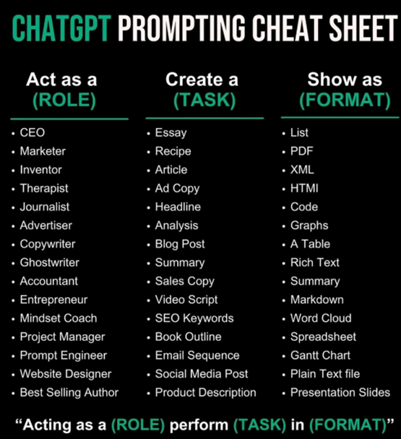

Slide 15
AI apps they used
Gemini AI, ChatGPT, Bing AI, Google BARD, Perplexity AI. Various reasons (uses UpToDate information enhancing your presentation, already use for other classes, etc.)

Slide 16
1. An email to a potential new customer assuming you are selling Heineken, Heineken Light, and Heineken Zero to the Duluth Entertainment Convention Center (DECC) for events at Amsoil Arena.

Slide 17
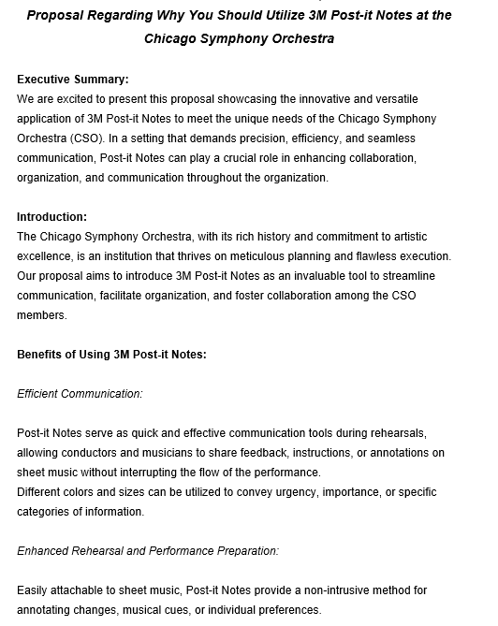
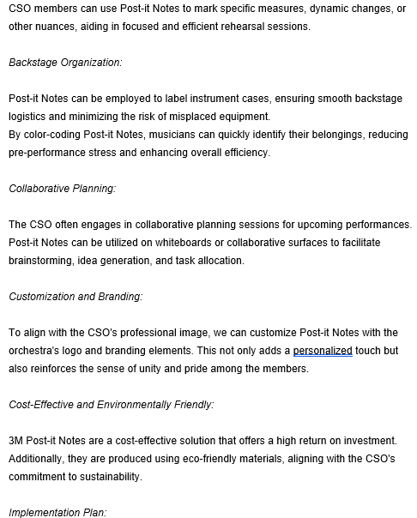
2. A 3-page proposal outlining how your product (3M Post It Notes) could meet the needs of the Chicago Symphony Orchestra.

Slide 18
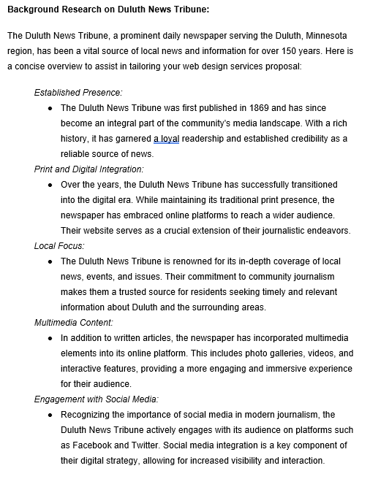
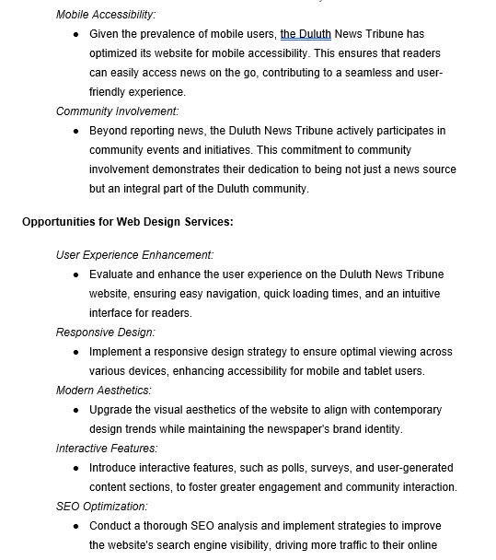
3. Provide background research on the Duluth News Tribune, assuming I am going to be selling them web design services.

Slide 20
Agenda
Introduction
Building confidence
Engaging the audience
Visual aids
Final tips & takeaways

