Slide 1
Raj Agnihotri Morrill Professor, Mary Warner Fellow, Director of Ivy Sales Forum, and Assistant Dean for Industry Engagement Ivy College of Business, Iowa State University Michael (Mike) Krush Professor of Marketing, Associate Director National Strategic Selling Institute Daniel D. Burke Chair For Faculty Kansas State University
AI Tsunami and the Emergence of Feeling Economy
The Bright Future of Relationship Selling Jobs

Slide 2
Agenda
The concept of feeling economy
01
The current landscape of AI
02
The future of relationship-selling jobs
03

Slide 3
The evolution of economies
Mechanical Economy
Thinking Economy
Feeling Economy
Huang, M. H., Rust, R., & Maksimovic, V. (2019). The feeling economy: Managing in the next generation of artificial intelligence (AI). California Management Review, 61(4), 43-65.

Slide 4
Feeling Economy
Biology mostly limits machines today to the thinking intelligence realm.
When AI performs many thinking tasks, human workers gravitate more toward interpersonal and empathetic tasks. This is the main reason for the emergence of the Feeling Economy.
Feeling/empathetic tasks are communicating with people, establishing and maintaining relationships, and influencing others.

Slide 5
Workforce nature
Human employment and wages will be more attributable to feeling tasks and jobs.
It is characterized by humans doing the feeling tasks and machines doing the thinking tasks.

Slide 6
The Current Landscape of AI

Slide 7
Organizations Regularly Using AI in Given Functions
(McKinsey Global Survey)
Source: The State of AI in 2023: Generative AI’s Breakout Year (McKinsey & Company)

Slide 8
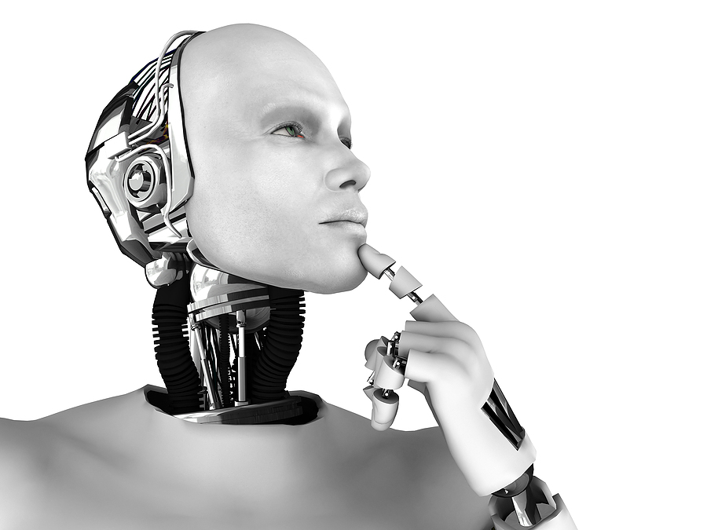
Are all AI tools the same?

Slide 9
Conversational AI vs. Generative AI
Differ in their applications, outputs, features, capabilities, and objectives.
GenAI models are built upon the diverse data that allows these models to recognize a wide range of prompts and create content that fits them.
Conversational AI models are built upon large volumes of data focused on the most common ‘context’ questions, responses, and conversations and thus mimic human speech involving personalized and insightful communication.

Slide 10
Real-life applications of Conversational AI
Conversational AI chatbots: AI-powered chatbots are designed to handle customer inquiries efficiently. Its NLP capabilities ensure accurate responses and improve customer satisfaction by resolving queries promptly.
Voice assistants: Platforms (e.g., Alexa, Haptik, and Siri) use conversational AI to understand and respond to user commands.
Social media interactions: Through social media platforms, businesses can leverage conversational AI to interact with internal and external stakeholders.

Slide 11
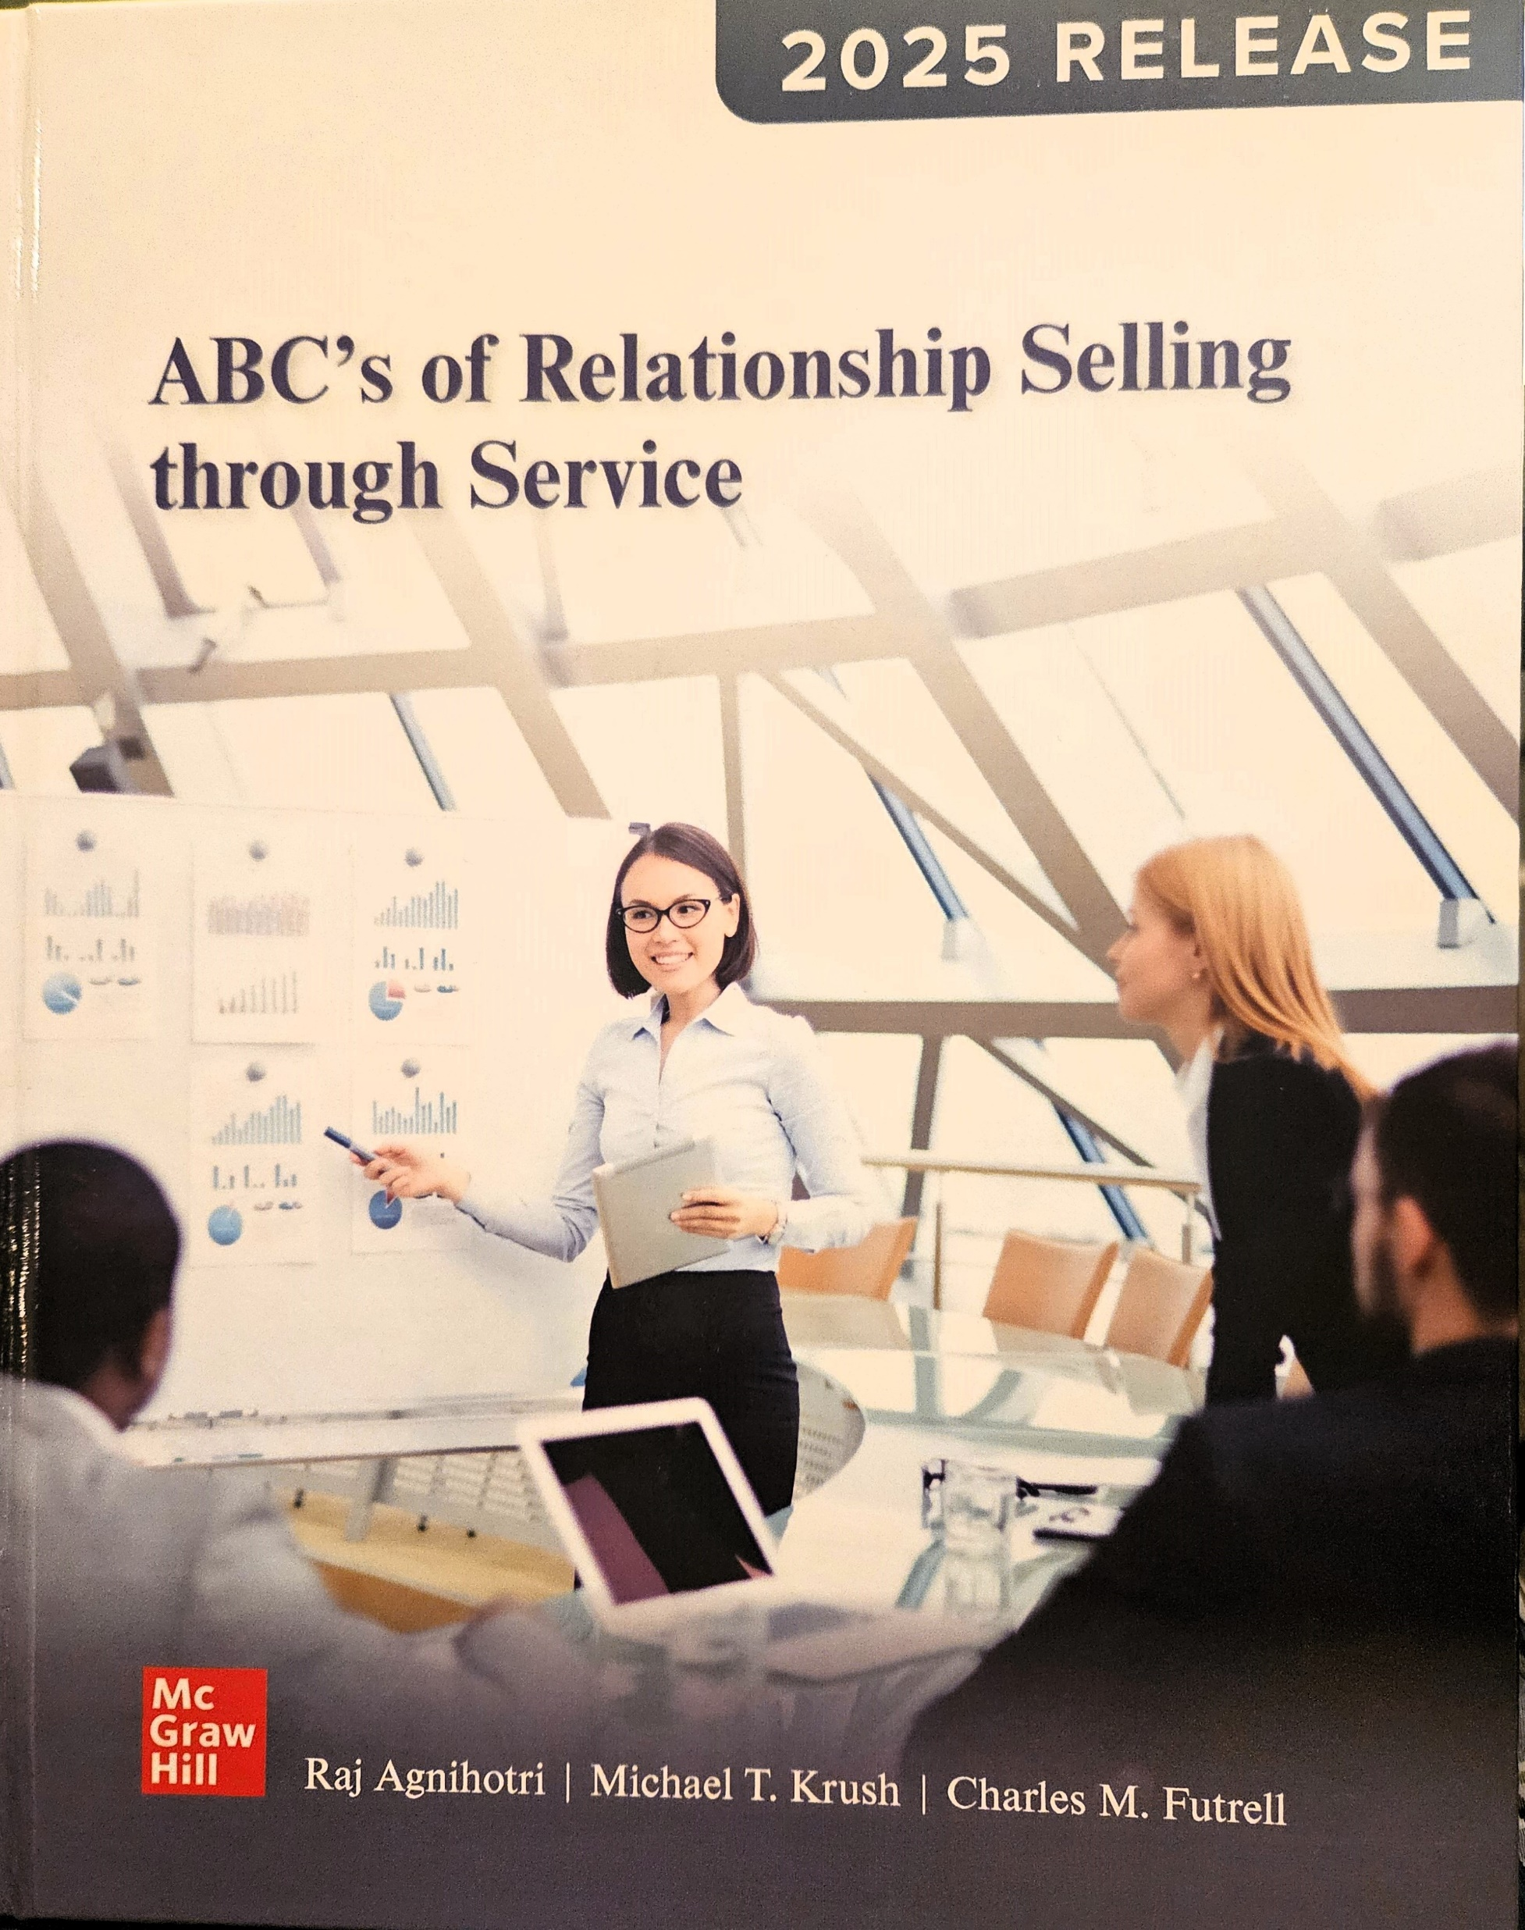
Conversational AI and Relationship Selling

Slide 12
AI and Future of Relationship Selling Jobs

Slide 15
Percent of Time Sales Reps Invest In Non-Selling Activities

Slide 17
Notes:
“Reps spend 70% of their time on nonselling tasks — a figure that is virtually unchanged from the 2022 State of Sales report, when reps spent 72% of their time on nonselling tasks.”

Slide 18
Possibilities
Advantages
Applications
Pattern recognition
(Classification)
Insights
Social listening
Superior Predictive Power
(Prediction)
Forecasting
Targeting
Generate Copies & Images
(Generation)
Personalization
Communications

Slide 19
“Agentforce” is a layer of Salesforce’s software package, providing customers who buy in with quick-to-set-up “agents” that can complete various simple tasks in sales, marketing, commerce and more. “
San Francisco Gate (SFGate). "SF's Salesforce Begins 2,000-Worker ‘Hiring Surge’ for Selling AI." SFGate, 2024. https://www.sfgate.com/tech/article/salesforce-hiring-2000-account-executives-19989301.php.. https://www.salesforce.com/agentforce/

Slide 24
Notes:
———. “50 Sales Statistics That Reveal How Great Teams Sell.” Salesforce, October 4, 2024. https://www.salesforce.com/blog/15-sales-statistics/.

Slide 25
Notes:
———. “50 Sales Statistics That Reveal How Great Teams Sell.” Salesforce, October 4, 2024. https://www.salesforce.com/blog/15-sales-statistics/.

Slide 28
Integrating AI into the Relationship Selling Process

Slide 29
CONTACT US: Raj Agnihotri: raj2@iastate.edu Mike Krush: mikekrush@ksu.edu
Thank you!

